Slide 1



SERVICE REGISTRY & DISCOVERY
#1
MICROSERVICES ARCHITECTURE

Slide 3

About me
Senior software developer
7+ years of experience
Polyglot programmer
Passion
Facebook – https://www.facebook.com/greenlearner
LinkedIn - https://www.linkedin.com/in/arvind-kumar-108a4b2b/

Slide 4
SERVICE REGISTRY & DISCOVERY
ARVIND
#2
Introduction
MICROSERVICES ARCHITECTURE

Slide 5
Introduction to service registry & discovery
Important for microservices architecture
Client Side service discovery
Server side servicer discovery

Slide 6
A microservices-based application typically runs in virtualized or containerized environments. The number of instances of a service and its locations changes dynamically.
We need to know where these instances are and their names to allow requests to arrive at the target microservice. This is where tactics such as Service Discovery come into play.
The Service Discovery mechanism helps us know where each instance is located. In this way, a Service Discovery component acts as a registry in which the addresses of all instances are tracked.
The instances have dynamically assigned network paths. Consequently, if a client wants to make a request to a service, it must use a Service Discovery mechanism
A microservice needs to know the location (IP address and port) of every service it communicates with. If we don’t employ a Service Discovery mechanism, service locations become coupled, leading to a system that’s difficult to maintain

Slide 7
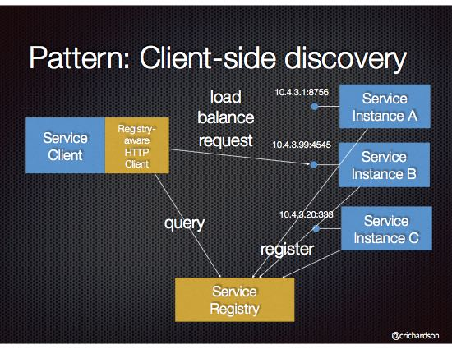
Client Side service discovery
Netflix Eureka

Slide 8
Client Side
When using Client-Side Discovery, the Service Consumer is responsible for determining the network locations of available service instances and
load balancing requests between them. The client queries the Service Register. Then the client uses a load-balancing algorithm to choose one of the available service instances and
performs a request.

Slide 9
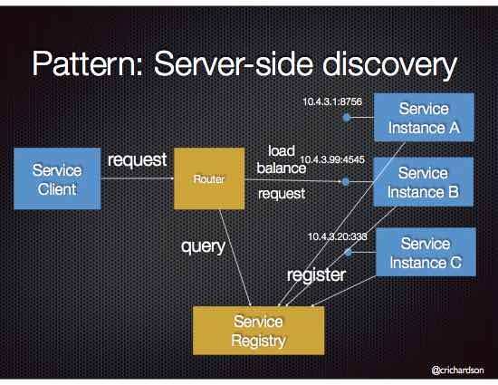
Server side service discovery
AWS Elastic Load Balancer (ELB)

Slide 10
The client makes a request to a service via a load balancer that acts as an orchestrator. The load balancer queries the Service Registry and routes each request to an available service instance.
creating this level of abstraction makes the Service Consumer lighter, as it doesn’t have to deal with the lookup procedure.
On the other hand, we must set up and manage the Load Balancer, unless it’s already provided in the deployment environment

Slide 11
Application design for demo
E
U
R
E
K
A
S
E
R
V
E
R
DoctorService
Eureka client
Doctor Portal
PatientService
Eureka client
DiseaseService
Eureka client

Slide 12

SERVICE REGISTRY & DISCOVERY
ARVIND
#3
Demo – spring boot + eureka Server
MICROSERVICES ARCHITECTURE

Slide 13
SERVICE REGISTRY & DISCOVERY
ARVIND
#4
Demo – spring boot + eureka CLIENT
MICROSERVICES ARCHITECTURE

Slide 14
SERVICE REGISTRY & DISCOVERY
ARVIND
#5
Demo – spring boot + eureka discovery CLIENT
MICROSERVICES ARCHITECTURE

Slide 15
Application design for demo
E
U
R
E
K
A
S
E
R
V
E
R
DoctorService
Eureka client
Doctor Portal
PatientService
Eureka client
DiseaseService
Eureka client

Slide 16
Introduction to service registry & discovery

Slide 17
Introduction to service registry & discovery

Slide 18
Introduction to service registry & discovery

Slide 19
Introduction to service registry & discovery

Slide 20
Introduction to service registry & discovery

Slide 21
Introduction to service registry & discovery

Slide 22
Introduction to service registry & discovery

